Slide 1
CHAPTER 7
GEOMETRIC OPERATIONS

Slide 2
WHAT WILL WE LEARN?
What do geometric operations do to an image and what are they used for?
What are the techniques used to enlarge/reduce a digital image?
What are the main interpolation methods used in association with geometric operations?
What are affine transformations and how can they be performed using MATLAB?
How can I rotate, flip, crop, or resize images in MATLAB?
What is image registration and where is it used?

Slide 3
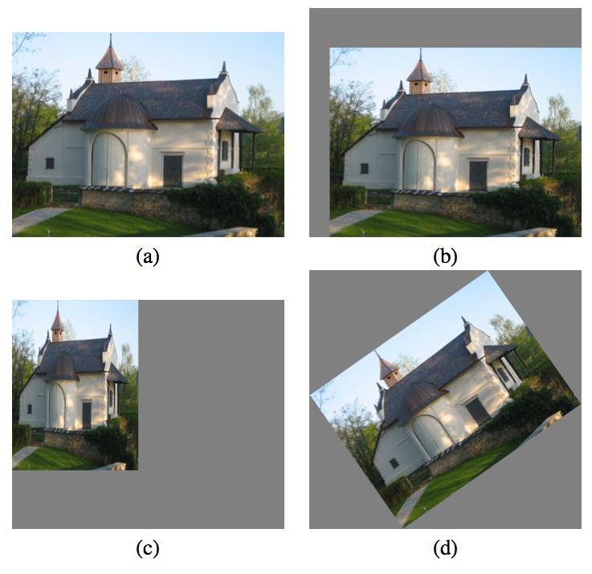
Examples of geometric operations

Slide 4
Geometric Operations…
Modify the geometry of an image by repositioning pixels in a constrained way.
Modify the spatial relationships between groups of pixels representing features or objects of interest within the image.
Are used for different purposes:
Correction of geometric distortions introduced during the image acquisition process;
Special effects (e.g., twirling, bulging, or squeezing);
As part of image registration

Slide 5
Geometric Operations…
Two basic components:
mapping function, specified using a set of spatial transformation equations (and a procedure to solve them)
and
interpolation methods, used to compute the new value of each pixel in the spatially transformed image.

Slide 6
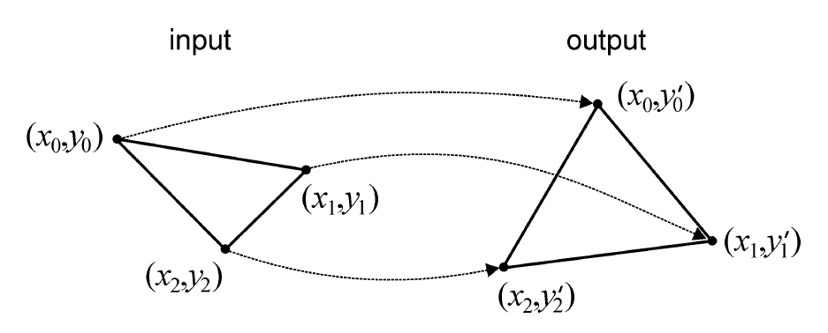


Mapping and Affine Transformations

Slide 7
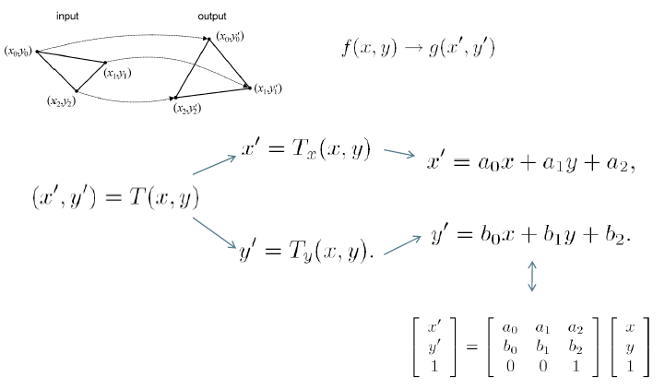
Mapping and Affine Transformations

Slide 8
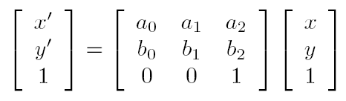
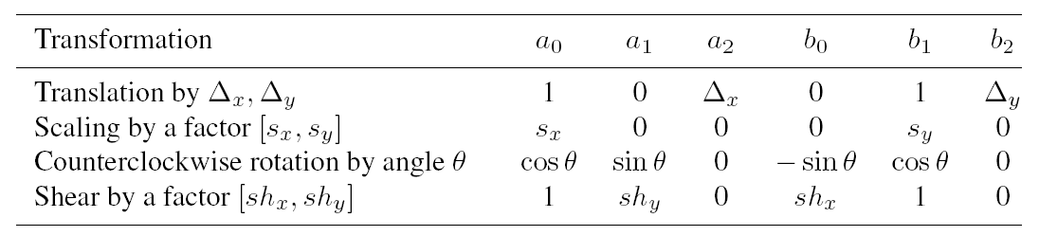
Mapping and Affine Transformations

Slide 9
Affine transform using MATLAB
maketform and imtransform functions
Example 7.1:
filename = 'any image of your choice'
I = imread(filename);
% Rotation
Ta = maketform('affine',[cosd(30)
-sind(30) 0; sind(30) cosd(30) 0; 0 0 1]');
Ia = imtransform(I,Ta);
%Scaling
Tb = maketform('affine',[3.5 0 0; 0 3.5 0;
0 0 1]');
Ib = imtransform(I,Tb);
% Translation
xform = [1 0 25; 0 1 15; 0 0 1]';
Tc = maketform('affine',xform);
Ic = imtransform(I,Tc, 'XData', [1 (size(I,2)+xform(3,1))], 'YData',[1 (size(I,1)+xform(3,2))],'FillValues', 128 );
% Shearing
Td = maketform('affine',[1 3 0; 2 1 0; 0 0 1]');
Id = imtransform(I,Td);

Slide 10
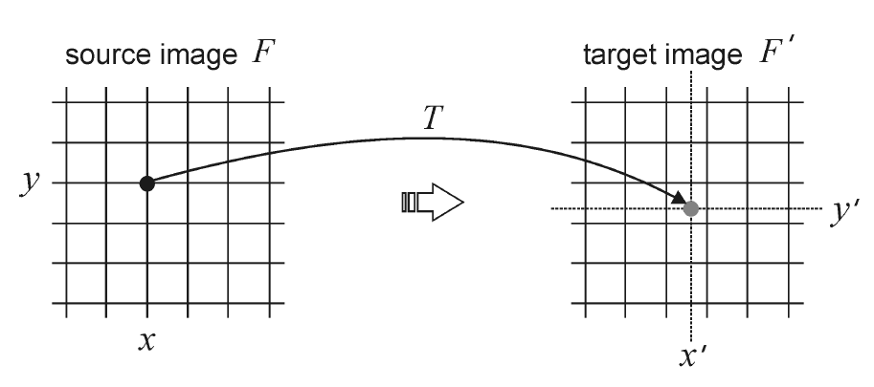
Interpolation methods
Forward mapping

Slide 11
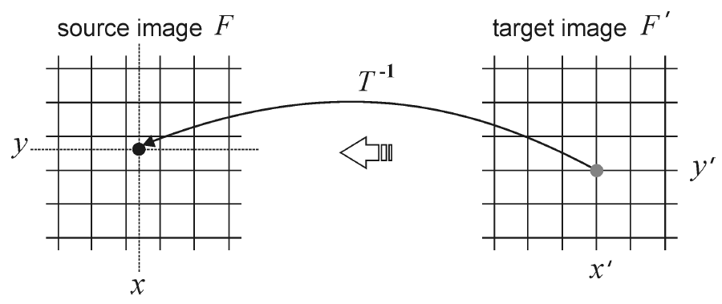
Interpolation methods
Backward mapping

Slide 12
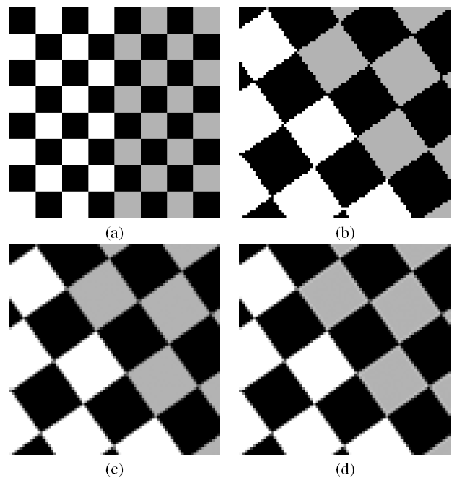
Interpolation methods
Zero-order (nearest neighbor) interpolation
First-order (bilinear) interpolation
Higher-order interpolations (e.g., bicubic)

Slide 13
Geometric operations using MATLAB
Resizing / zooming: imresize
Translation: maketform and imtransform
Rotation: imrotate
Cropping: imcrop
Flipping: flipud and fliplr

Slide 14

Other geometric operations and applications
Warping: the “transformation of an image by reparameterization of the 2D plane”
Quadratic warp:
Usually specified using control points in the source image and mapping them to specified locations in the destination image.
Control points are usually associated with key locations and features in the image, such as corners of objects.

Slide 15
Nonlinear image transformations
Twirling
Causes an image to be rotated around an anchor point of coordinates (xc, yc) with a space-variant rotation angle.
The angle has a value of α at the anchor point and decreases linearly with the radial distance from the center.
The effect is limited to a region within the maximum radius r_{max}. All pixels outside this region remain unchanged.

Slide 16
Nonlinear image transformations
Twirling - inverse mapping function:
and
where:

Slide 17
Nonlinear image transformations
Rippling
The ripple transformation causes a local wave-like displacement of the image along both directions, x and y.
The parameters for this mapping function are the (nonzero) period lengths Lx, Ly (in pixels) and the associated amplitude values Ax, Ay.

Slide 18
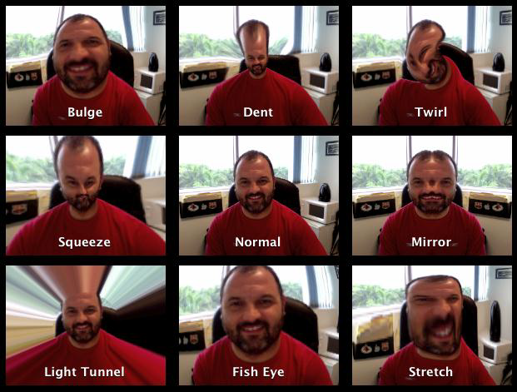
Nonlinear image transformations
Image deformations using Photo Booth:

Slide 19
Other geometric operations
Morphing
Geometric transformation technique that gradually converts an image into another.
The idea is to produce a visible metamorphosis effect as intermediate images are being displayed.
Image morphing was quite popular in TV, movies, and advertisements in the 1980s and 1990s, but has lost impact since then.

Slide 20
Other geometric operations
Morphing
Modified version of piecewise warping, in which the user specifies control points in both the initial and final images.
These control points are then used to generate two meshes (one from each image).
Affine transformations relate the resulting meshes.
Important aspect of morphing: the warp is computed incrementally, one small step at a time, in combination with a dissolve effect from the initial image to the final one.

Slide 21
Other geometric operations
Seam carving
Recently proposed (2007) image operator for content-aware image resizing.
Basic idea: to find seams* in the original image and use that information to either:
(i) reduce the image size by removing (“carving out”) the seams that contribute the least to the image's contents; or
(ii) enlarge the image by inserting additional seams.
*A seam is an “optimal 8-connected path of pixels on a single image from top to bottom, or left to right, where optimality is defined by an image energy function”

Slide 22
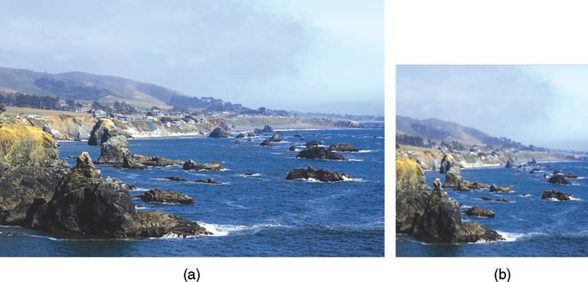
Other geometric operations
Seam carving
By applying these operators in both directions the image can be retargeted to a new size with very little loss of meaningful contents.
Example (Fig. 7.7):

Slide 23
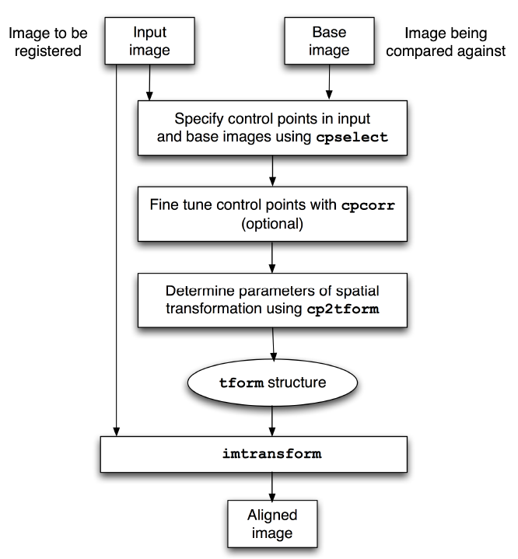
Image registration using MATLAB

Slide 24
Hands-on
Tutorial 7.1: Image cropping, resizing, flipping, and rotation (page 138)
Tutorial 7.2: Spatial transformations and image registration (page 142)

